Slide 1


Department of Computer Science and Engineering
PRIVACY PRESERVING BLOCKCHAIN BASED SYSTEM FOR DISEASES MANAGEMENT
HARSHINI B [REGISTER NO:211419104098] HEMAVARSHINI D [REGISTER NO:211419104103] NANDHINI G [REGISTER NO:211419104174]
Guide Name
Mrs. R. Devi, M.E.,
Coordinator Name
Dr. Kavitha Subramani M.E., Ph.D.,

Slide 2
ABSTRACT
The shortage of people, institutions, and pharmaceuticals in public health systems is one of the key problems affecting the healthcare industry in many developing nations. Information and communication technology has demonstrated its capacity to raise data security, lower costs, and improve medical quality during the past decade. These technologies can be used by developing nations to enhance healthcare services and upkeep. Patient's medical information is frequently provided using the Internet of Things. Yet, there are more security and privacy vulnerabilities with this technology. We describe a Blockchain-based Health Information Exchange (HIE) in our system. We suggest using Blockchain technology to improve security and privacy in healthcare systems in addition to data encryption. In comparison to existing methods, data are stored in an Inter Planetary File System (IPFS) in off-chain database. To ensure blockchain scalability, re-encryption proxies with the aid of Ethereum blockchain technology are employed based on Proof of Authority (PoA) to speed up the data storage. Unfortunately, Inter Planetary File System (IPFS) lacks strong economic incentives and is untrustworthy with regard to private data. However, security concerns are solved by combining the Advanced Encryption Standard (AES) and Secure Hash Algorithm 256-bit (SHA-256) algorithms with Blockchain to encrypt data and restrict access to it.

Slide 3
Literature Survey
YEAR | AUTHOR NAME | PAPER DETAILS | METHODOLOGY | MERITS | DEMERITS
2022 | Kebira Azbeg , Ouail Ouchetto, Said Jai Andaloussi | TITLE:Access Control and Privacy-Preserving Blockchain-Based System for Diseases Management JOURNAL: IEEE | TECHNIQUE: IPFS, Inter Planetary File System, Proxy re-encryption | It is a protocol, hypermedia, file sharing Peer to Peer network for storing and sharing data. | It is not fit to store large amount of data and not have the incentive layers to verify the integrity of the data that it stores.
LINK: https://ieeexplore.ieee.org/document/9819963

Slide 4
Literature Survey
YEAR | AUTHOR NAME | PAPER DETAILS | METHODOLOGY | MERITS | DEMERITS
2019 | Ayesha Shahnaz , Usman Qamar, Ayesha Khalid | TITLE: Using Blockchain for Electronic Health Records VOLUME: 7 JOURNAL: IEEE | TECHNIQUE: Consensus algorithm, Granular access method | It allows the blockchain to validate and confirm transactions and operations, without the need for a third-party intermediary. | The proof of work (PoW) is costly and require a plenty of computing time and it is energy intensive.
LINK: https://ieeexplore.ieee.org/document/8863359

Slide 5
Literature Survey
YEAR | AUTHOR NAME | PAPER DETAILS | METHODOLOGY | MERITS | DEMERITS
2020 | Yan Zhuang, Lincoln R. Sheets, Yin-Wu Chen, Zon-Yin Shae, Jeffrey J.P. Tsai, Chi-Ren Shyu | TITLE: A Patient-Centric Health Information Exchange Framework Using Blockchain Technology VOLUME: 24 JOURNAL: IEEE | TECHNIQUE: Distributed Ledger Technology (DLT) | It includes decentralization and easier auditability, cost reductions, and automation | Due to inefficiency there is a possibility of 51%of attack
LINK: https://ieeexplore.ieee.org/document/9090282

Slide 6
YEAR | AUTHOR NAME | PAPER DETAILS | METHODOLOGY | MERITS | DEMERITS
2021 | Ahmad Musamih, Khaled Salah, Raja Jayaraman, Junaid Arshad, Mazin Debe, Yousof Al-Hammadi, Samer Ellahham | TITLE: A Blockchain-Based Approach for Drug Traceability in Healthcare Supply Chain VOLUME: 9 JOURNAL: IEEE | TECHNIQUE: Ethereum blockchain-based approach and off-chain | Decentralization interoperability and open source Permissioned network | It Uses a Complicated Programming Language and Investing Can Be Risky
LINK:https://ieeexplore.ieee.org/document/9316803

Slide 7
YEAR | AUTHOR NAME | PAPER DETAILS | METHODOLOGY | MERITS | DEMERITS
2019 | Leila Ismail, Huned Materwal, sherali Zeadally | TITLE: Lightweight Blockchain for Healthcare VOLUME: 7 JOURNAL: IEEE | TECHNIQUE: Lightweight Blockchain Architecture | It generates 11 times lower network traffic compared to the Bitcoin network as the number of blocks increases and shows a speedup of 67% in ledger | Since this proposed architecture does not fork the transactions on all the nodes as in Bitcoin and only the cluster heads maintain a copy of the ledger
LINK:https://ieeexplore.ieee.org/document/8869754

Slide 8
Problem Statement
In this project, we examine how the health information is exchange to another or to any other hospital with respect to the patient. Yet, there are more security and privacy vulnerabilities with this technology. We describe a Blockchain-based Health Information Exchange (HIE) in our system. The most remarkable feature about Blockchain is how much it lowers the severity of a data breach. There are numerous shared copies of the same data base in Blockchain, in contrast to traditional methods, which makes it more difficult to carry out a data breach attack or cyber-attack. With all of its anti-fraud capabilities, block chain technology has the potential to change a number of business sectors, including the healthcare industry, and make procedures smarter, more secure, transparent, and more efficient compared to the traditional processes.

Slide 9
Proposed System
The proposed system has overcome all the disadvantages listed in the existing system with the help of algorithms in the blockchain to ensure more security and privacy while sharing the information. So, the security concerns are solved by combining the Advanced Encryption Standard (AES) and Secure Hash Algorithm 256-bit (SHA-256) algorithms with Blockchain to encrypt data and restrict access to it. The benefits of Advanced Encryption Standard (AES) algorithm, It uses higher length key sizes such as 128, 192 and 256 bits for encryption. Hence it makes AES algorithm more robust security protocol against hacking. It is most common security protocol used for wide variety of applications such as wireless communication, financial transactions, e-business, encrypted data storage etc. For 128 bits, about 2¹²⁸ attempts are needed to break which makes it very difficult to hack in other words no one can hack the information. For the security concerns Secure Hash Algorithm 256-bit (SHA-256) is employed which obtain the leading position for the most secured algorithm and it's used for cryptographic security. Cryptographic hash algorithms produce irreversible and unique hashes where no two input values can produce same hash output. The larger the number of possible hashes, the smaller the chance that two values will create the same hash.

Slide 10
Software / Hardware used
Hardware requirements:
System | Core i5 Processor
Hard Disk | 250 GB
Monitor | 15’’ LED
Input Devices | Keyboard, Mouse
Ram | 4 GB
Software Requirements:
Operating System | Windows 10
Language | Java
Ide | Eclipse
Front End | HTML, CSS, JSP
Back End | My SQL 5.5

Slide 11
Methodology used
Algorithm Used
Advanced Encryption Standard (AES) algorithm
Secure Hash Algorithm 256-bit (SHA-256) algorithm

Slide 12
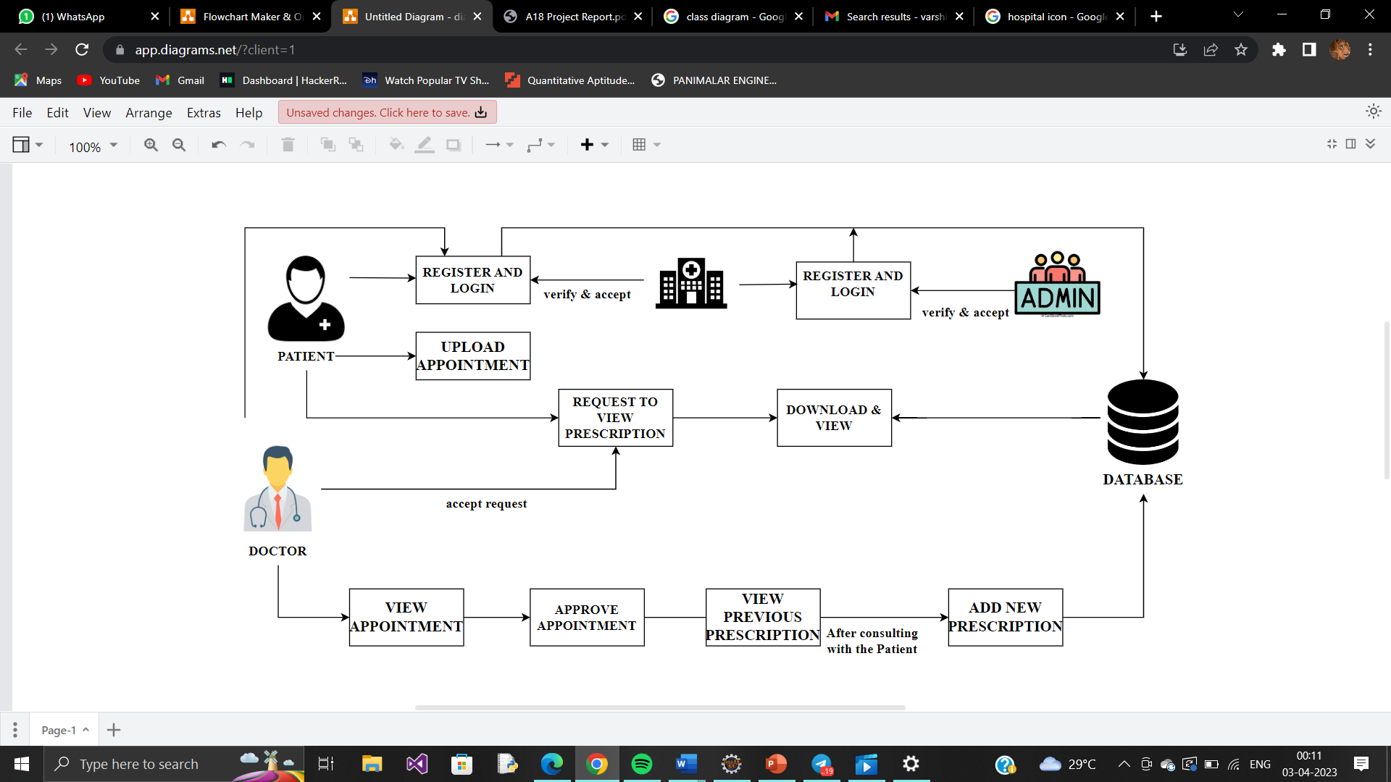
SYSTEM ARCHITECTURE

Slide 13
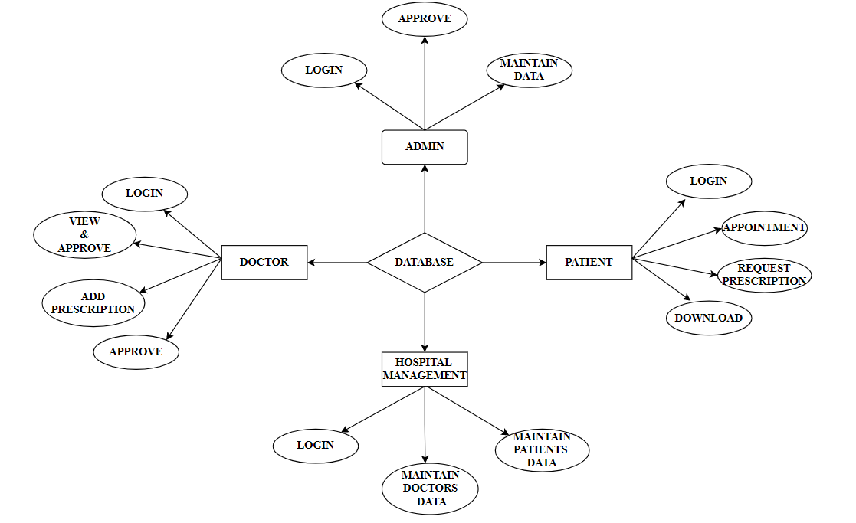
System Design – ER DIAGRAM

Slide 14
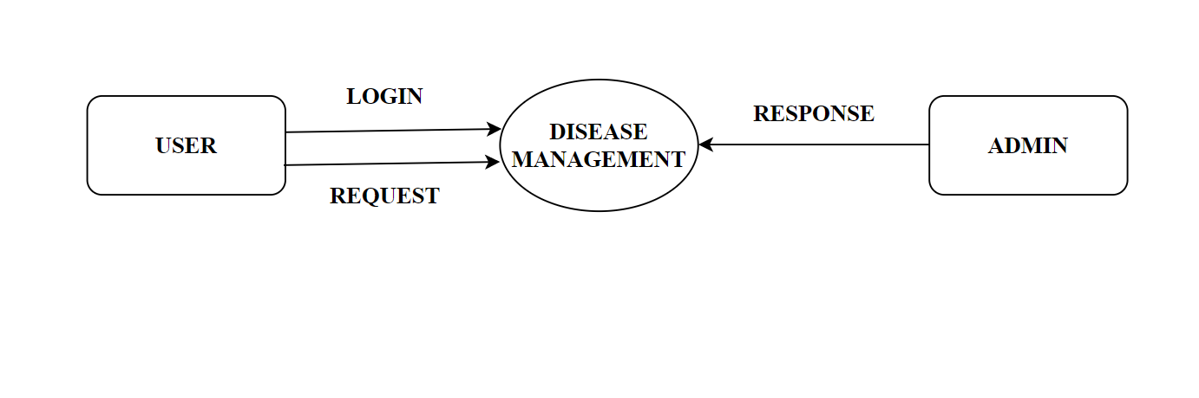
System Design – DFD DIAGRAM
LEVEL 0 DFD DIAGRAM

Slide 15
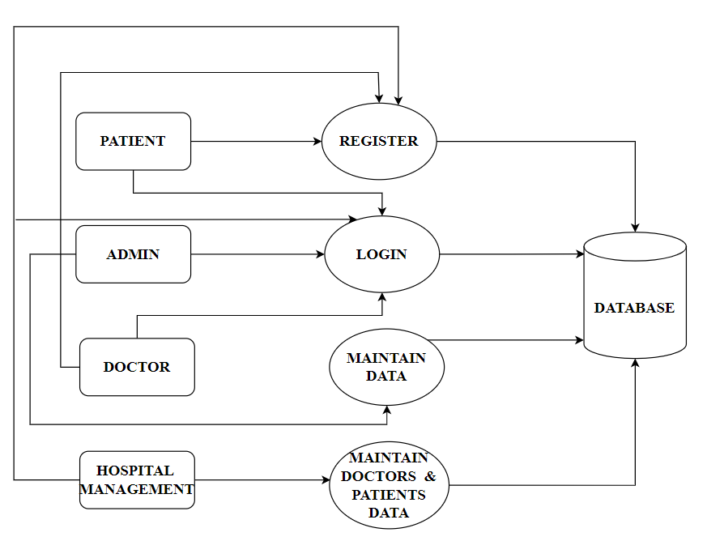
System Design – DFD DIAGRAM
LEVEL 1 DFD DIAGRAM

Slide 16
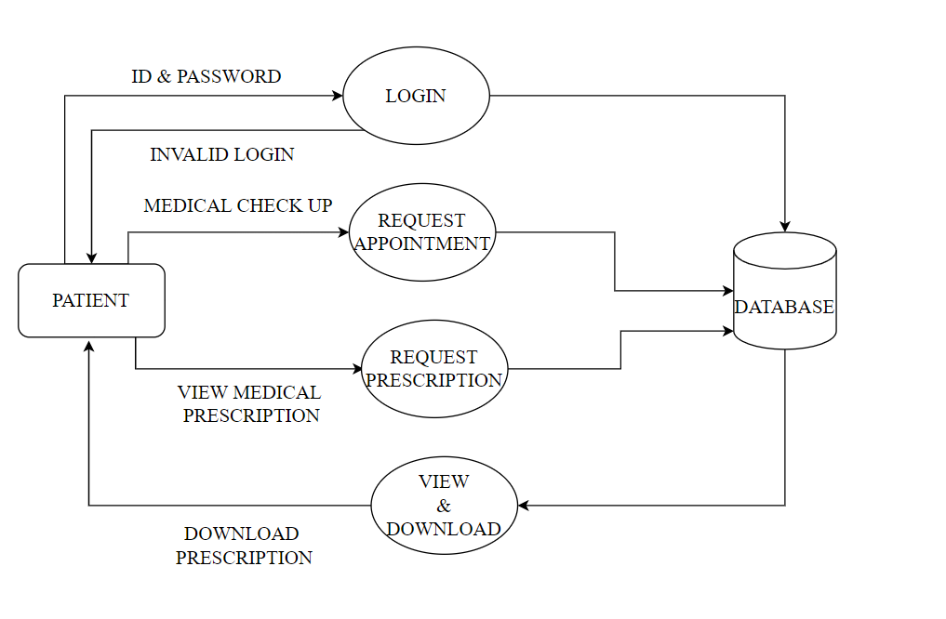
System Design – DFD DIAGRAM
LEVEL 2 DFD DIAGRAM (PATIENT)

Slide 17
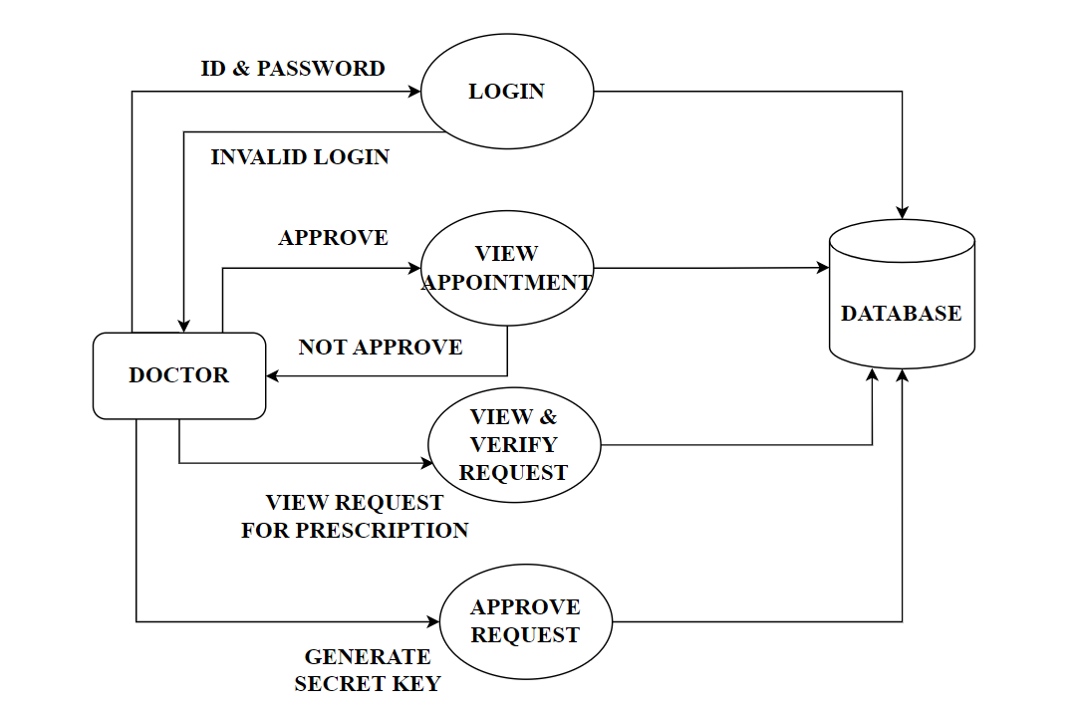
System Design – DFD DIAGRAM
LEVEL 2 DFD DIAGRAM (DOCTOR)

Slide 18
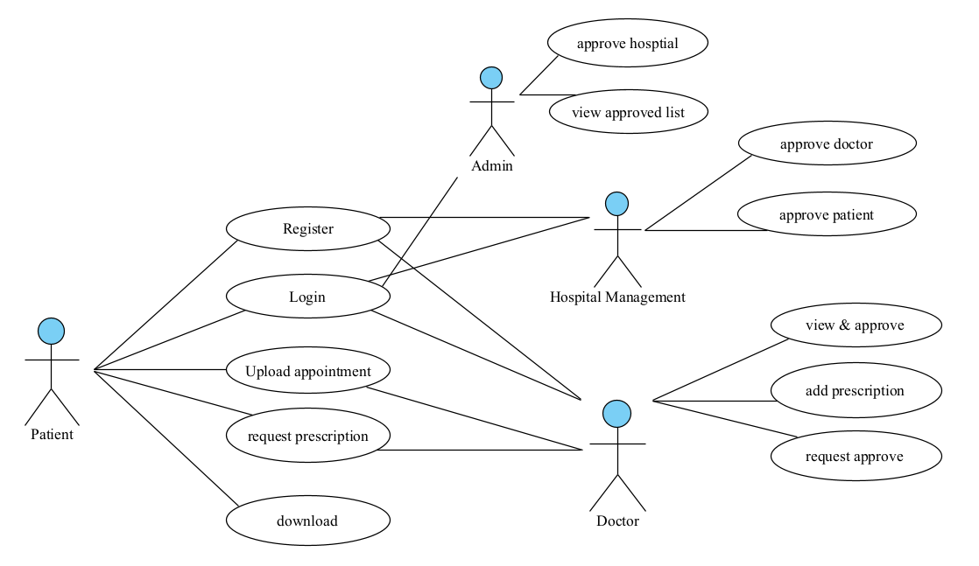
System Design – USECASE DIAGRAM

Slide 19
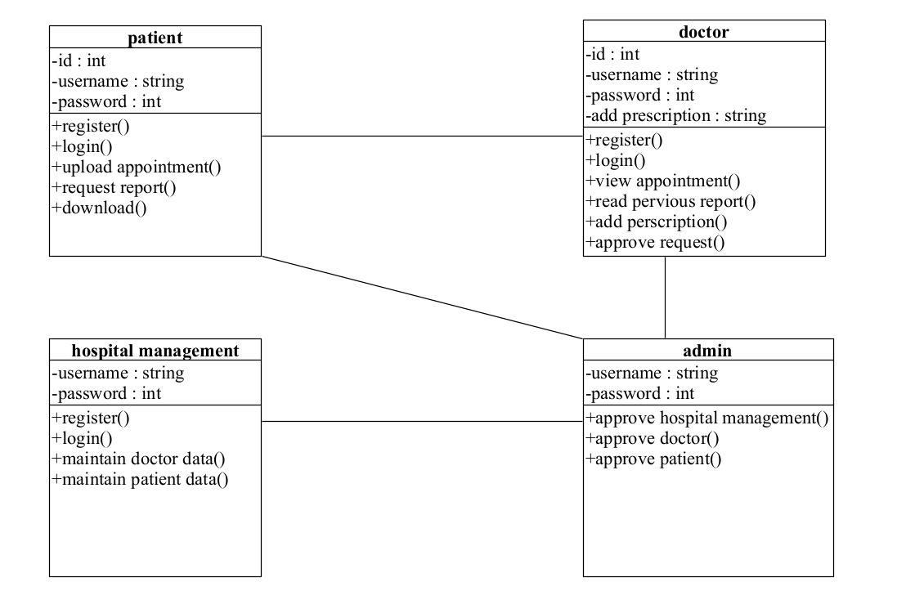
System Design – CLASS DIAGRAM

Slide 20
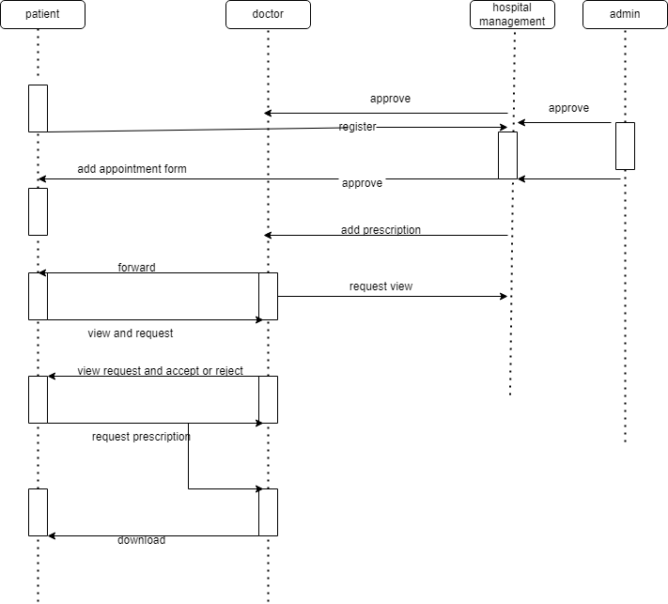
System Design – SEQUENCE DIAGRAM

Slide 21
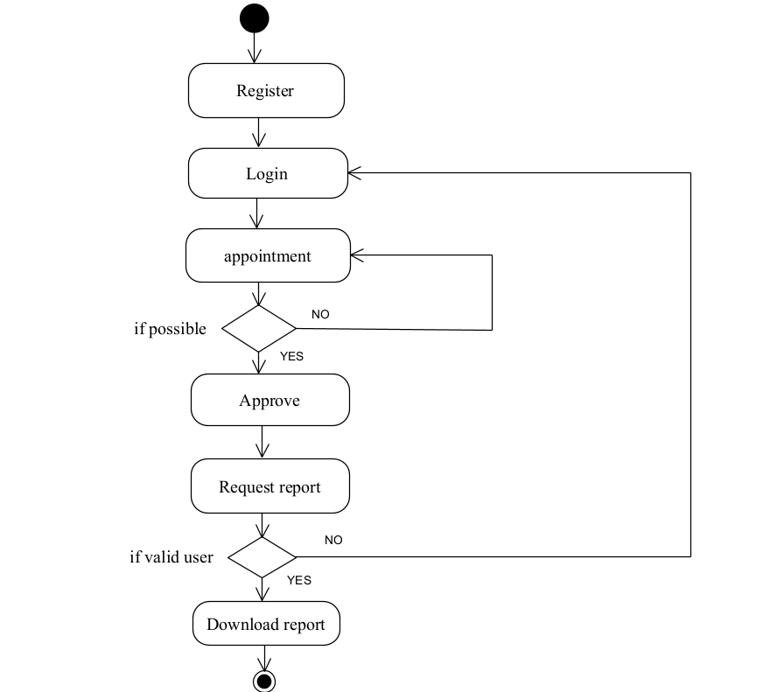
System Design – ACTIVITY DIAGRAM

Slide 22
Module Description
Admin
Hospital Management
Patient
Doctor

Slide 23
Module Description
ADMIN:
In this module, they confirm and approve the request of hospital management after verifying their hospital Registration and License Required of that particular hospital.
HOSPITAL MANAGEMENT:
In this module, the hospital management verifies and approve the doctor’s request and then they maintain the data of their respective doctor and their performances.
DOCTOR:
In this module, the doctor views the appointment form which have been uploaded by the patient and he either approve the application or not, and then proceed further process. The doctor adds the prescription of patient after the diagnosis and he can view the previous report or prescription of that particular patient and he cannot duplicate the patient’s previous prescription

Slide 24
Module Description
PATIENT:
In this module, the user uploads the appointment form of particular hospital. If the doctor accepts the appointment form, then the patient can visit the doctor for diagnosis. The patient can view their prescription by requesting the prescription report to the doctor. If the doctor accepts the request and then the patient can download the report or the prescription.

Slide 25
TESTCASES
MODULE NAME: DOCTOR
Test Case Id | Test Case Name | Input | Expected Output | Actual Output | Test Result (Pass/Fail)
TC01 | Register | Username, Phone no, Email ID, Password | User should be redirected to login page (Scr 2.6) | User should be redirected to login page (Scr 2.6) | Pass
TC02 | Login | Email, Password | Login Successful (Scr 2.7) | Login Successful (Scr 2.7) | Pass
TC03 | Response | Verify Patient ID | Request Accepted (Scr 2.11) | Request Accepted (Scr 2.11) | Pass
TC04 | Add Prescription | File type, PDF | Uploaded Successfully (Scr 2.13) | Uploaded Successfully (Scr 2.13) | Pass

Slide 26
TESTCASES
MODULE NAME: PATIENT
Test Case Id | Test Cases Name | Input | Expected Output | Actual Output | Test Result (Pass/Fail)
TC01 | Registration | Username, Phone number, Email ID, Password, | User should be redirected to login page (Scr 2.8) | User should be redirected to login page (Scr 2.8) | Pass
TC02 | Login | Email, Password | Login Successful (Scr 2.9) | Login Successful (Scr 2.9) | Pass
TC03 | Request | File | Request sent to doctor (Scr 2.14) | Request sent to doctor (Scr 2.14) | Pass
TC04 | Download | File | Downloaded Successfully (Scr 2.15) | Downloaded Successfully (Scr 2.15) | Pass

Slide 27
TESTCASES
MODULE NAME: ADMIN
Test Case Id | Test Cases Name | Input | Expected Output | Actual Output | Test Result (Pass/Fail)
TC01 | Login | Email, Password | Login Successful (Scr 2.2) | Login Successful (Scr 2.2) | Pass
TC02 | Response | Verify Hospital registration and license | Request Accepted (Scr 2.4) | Request Accepted (Scr 2.4) | Pass

Slide 28
TESTCASES
MODULE NAME: HOSPITAL MANAGEMENT
Test Case Id | Test Cases Name | Input | Expected Output | Actual Output | Test Result (Pass/Fail)
TC01 | Register | Email ID, Password, Hospital License | User should be redirected to login page (Scr 2.3) | User should be redirected to login page (Scr 2.3) | Pass
TC02 | Login | Email, Password | Login Successful (Scr 2.5) | Login Successful (Scr 2.5) | Pass
TC03 | Response | Verify doctor cerdentials | Request Accepted (Scr 2.7) | Request Accepted (Scr 2.7) | Pass

Slide 29

Screen Shots
Scr 2.1. Home page

Slide 30
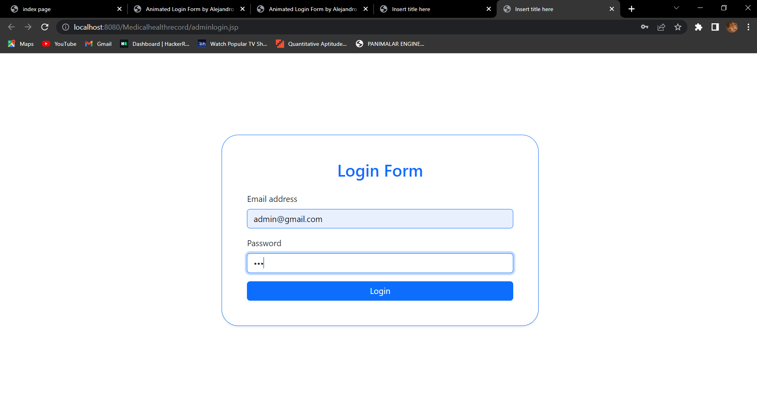
Scr 2.2. Admin Page

Slide 31
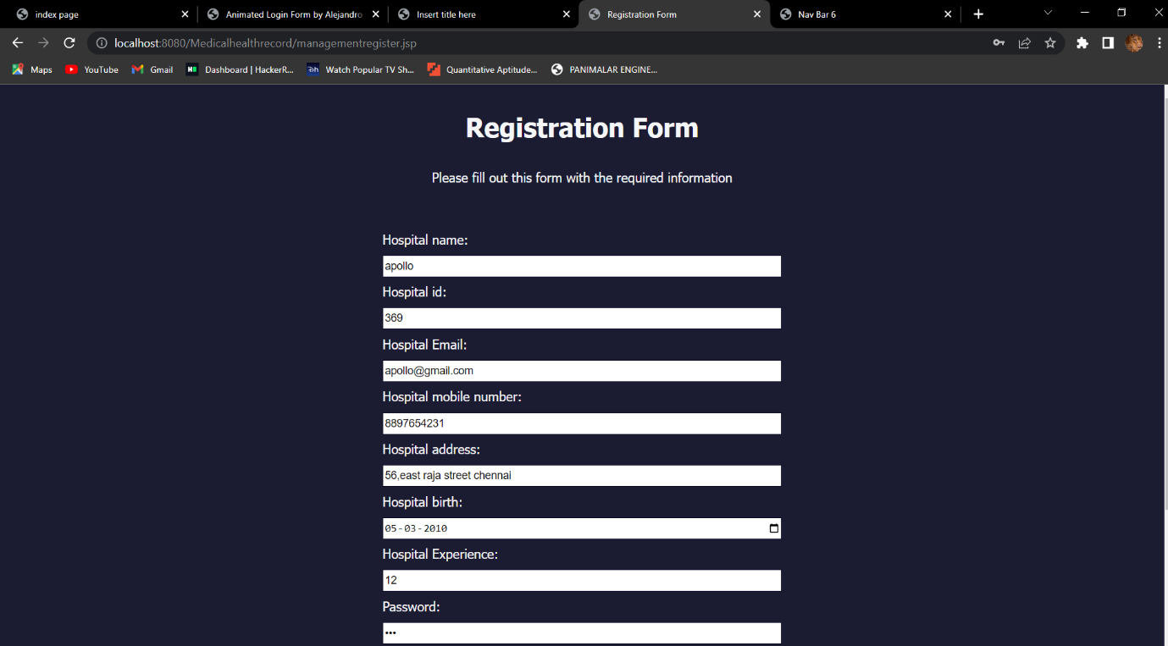
Scr 2.3. Hospital management register page

Slide 32
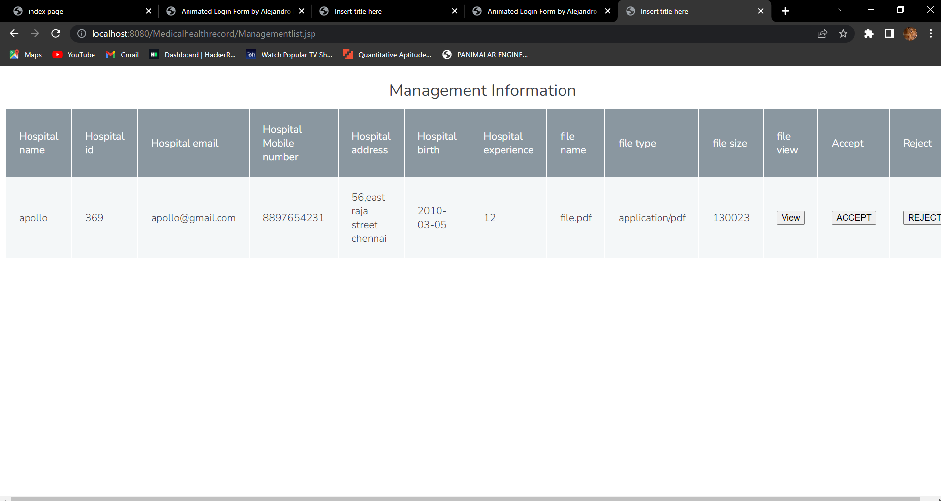
Scr 2.4. Management information

Slide 33
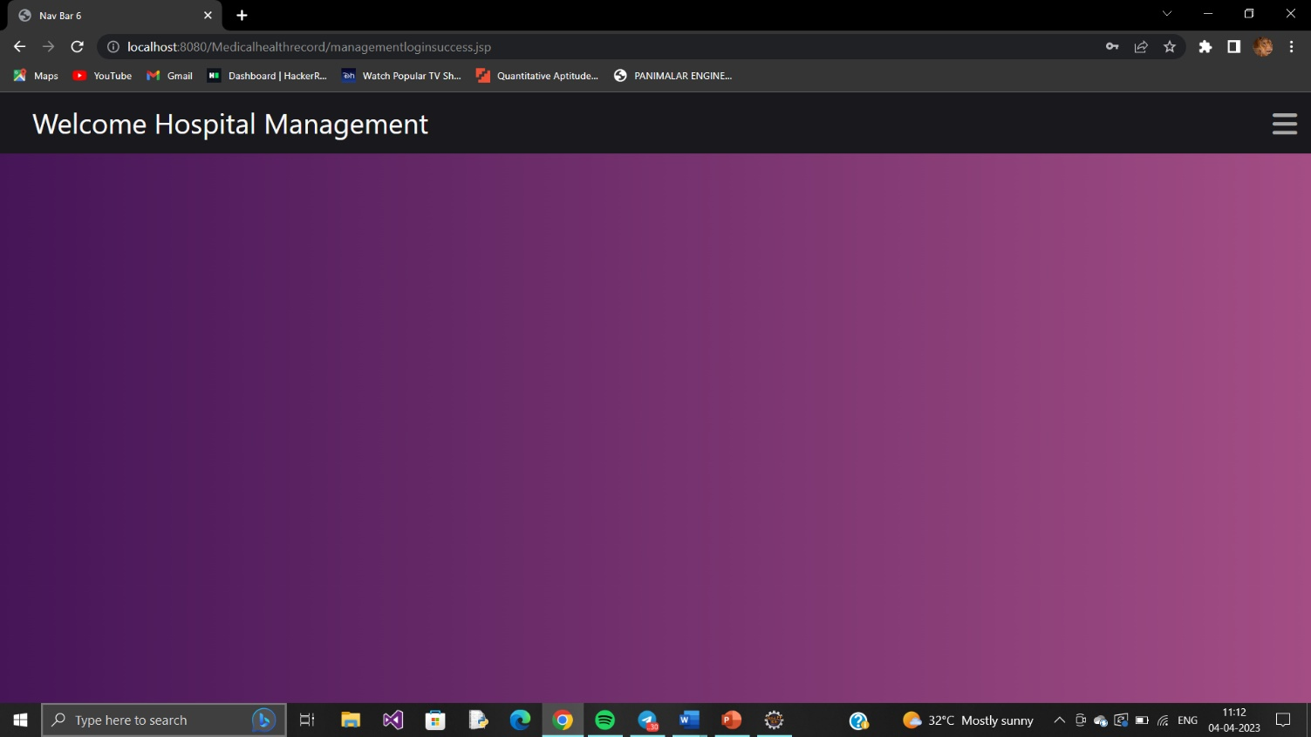
Scr 2.5. Hospital management home page

Slide 34
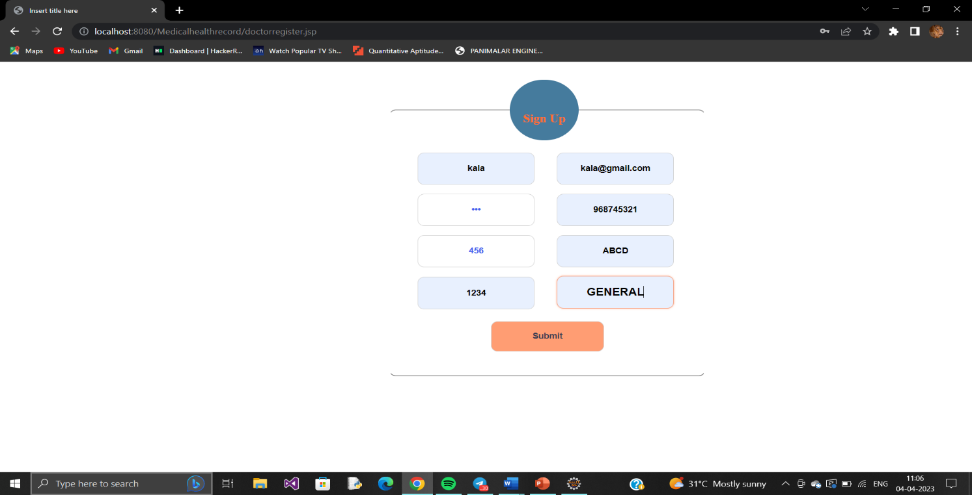
Scr 2.6. Doctor register page

Slide 35
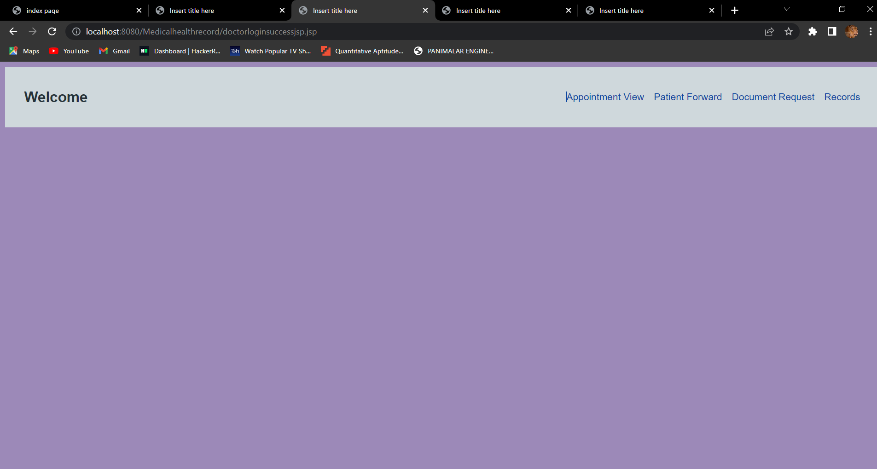
Scr 2.7. Doctor home page

Slide 36
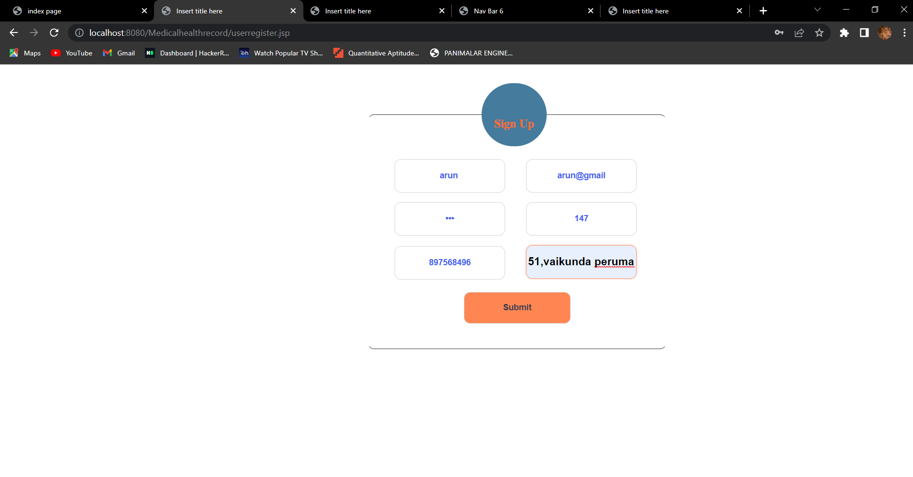
Scr 2.8. Patient register page

Slide 37
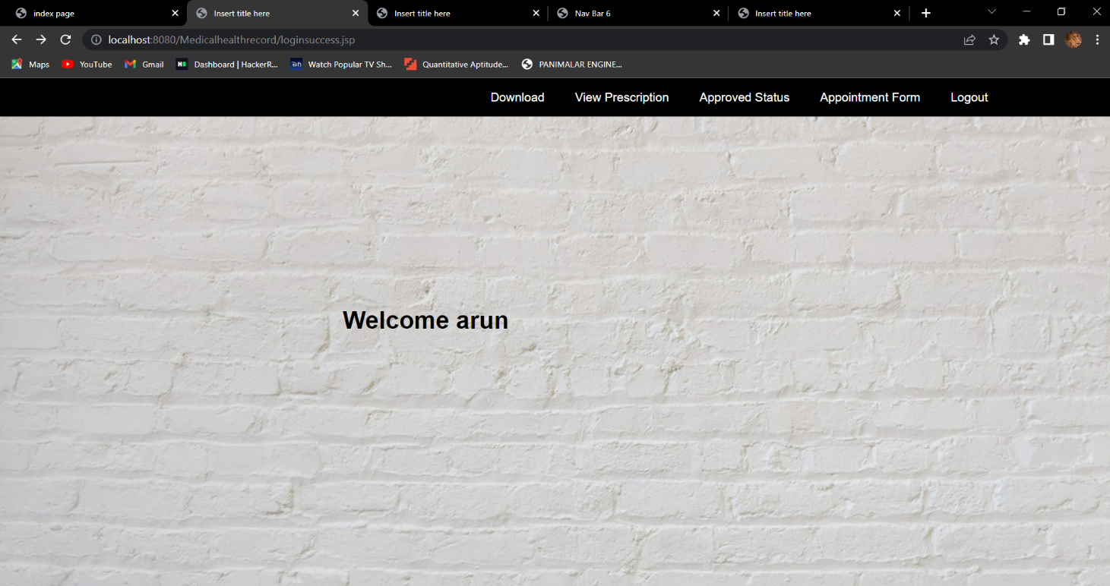
Scr 2.9. Patient home page

Slide 38
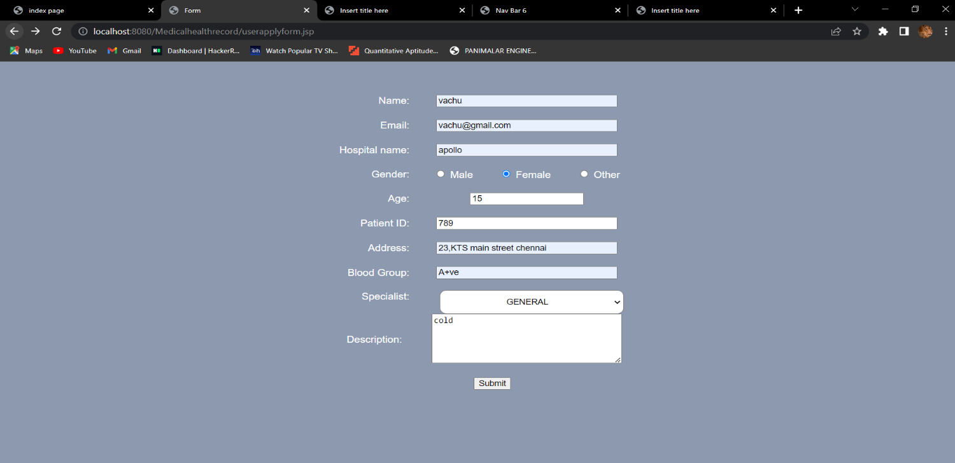
Scr 2.10. Appointment form

Slide 39
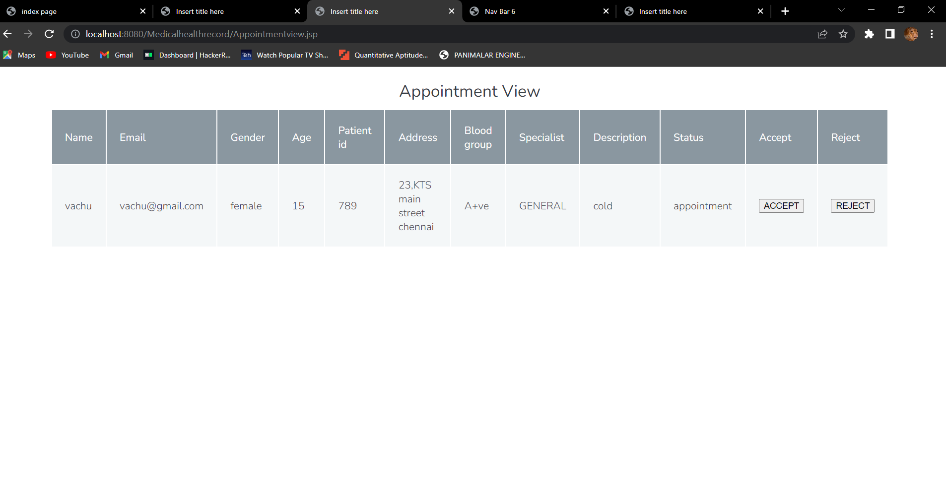
Scr 2.11. View appointment

Slide 40
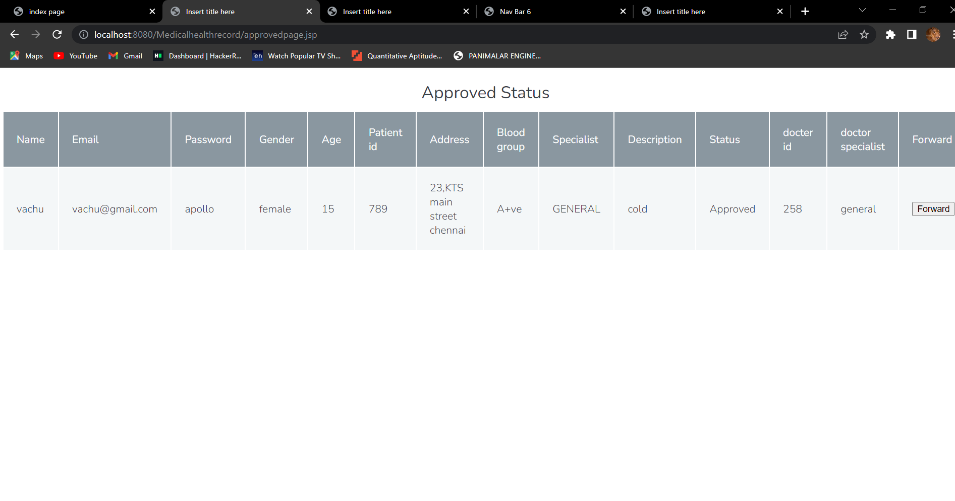
Scr 2.12. Appointment status

Slide 41
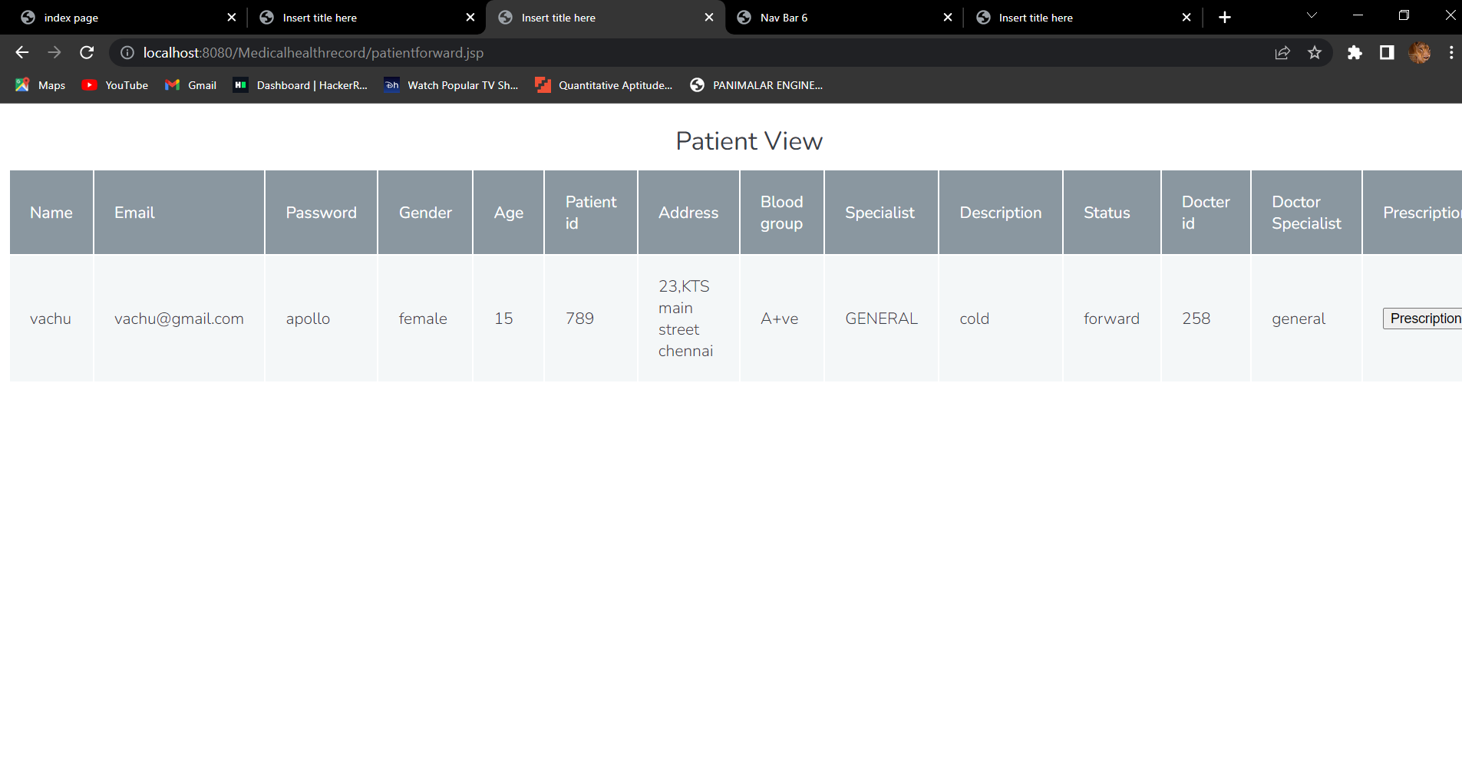
Scr 2.13. Prescription page

Slide 42
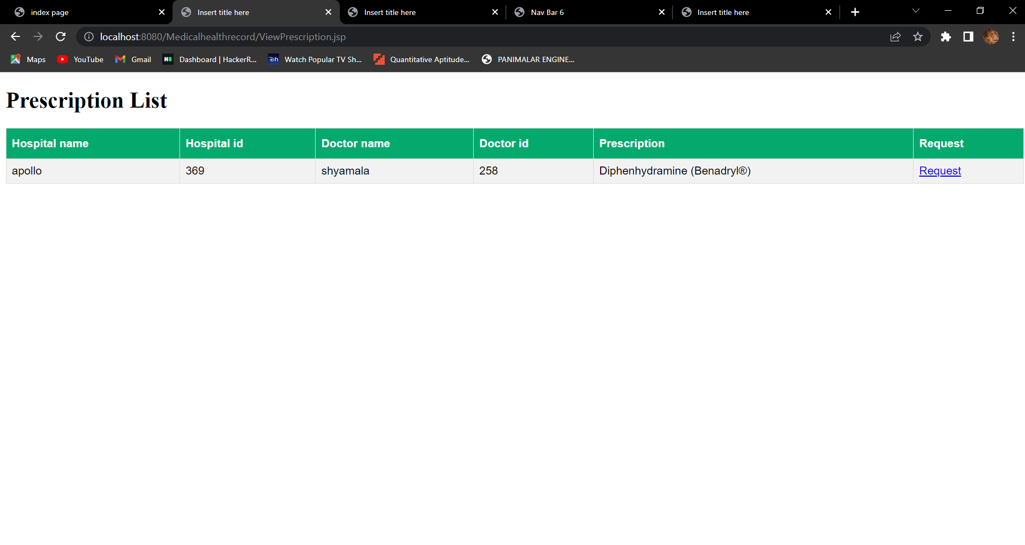
Scr 2.14. Request prescription

Slide 43
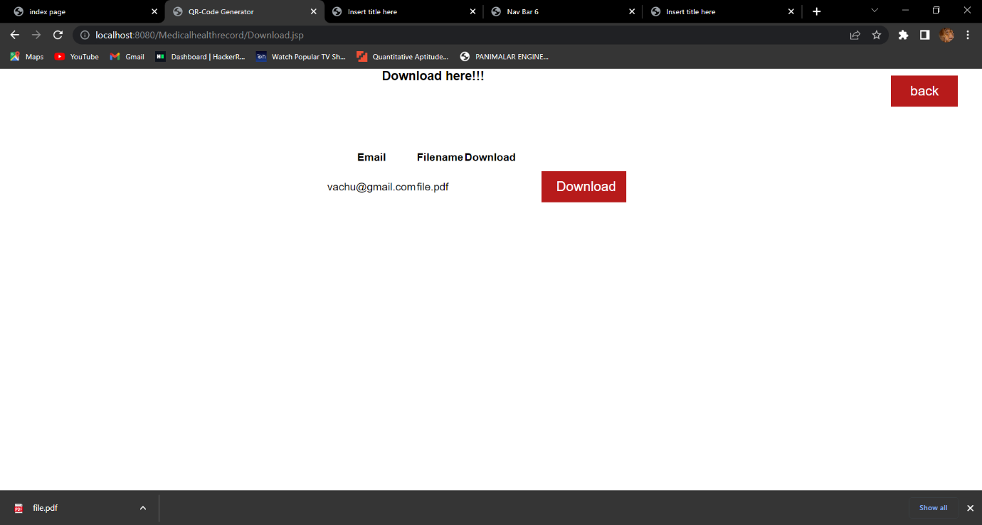
Scr 2.15. Download prescription

Slide 44
Conclusion / Feature Enhancement
Several sectors, including machine learning, banking and the military, are using the new blockchain. It also has some limitations, such as immutability in some applications where data can be modified. Despite these limitations, we must embrace and promote its widespread adoption across multiple industries. Users share a significant amount of data every day. In this project, we have provided a more secure way to share files and store them on a trusted platform like blockchain. This technology can partially eliminate all the disadvantages associated with a centralized network to share confidential health information within a hospital or between hospitals on a patient-by-patient basis. Sensitive data must be protected from unauthorized access. We explored how blockchain meets the complex security, storage, sharing and authentication requirements of data exploration. As a future work of this project, we will implement a real-world database system, Improving the efficiency of the protocol, according to the number and size of exchanged messages, and then implementing two additional algorithm

Slide 45
Reference Paper/ URL
[1] A. Aflaki, B. Feldman, and R. Swinney, “Becoming strategic: Endogenous consumer time preferences and multiperiod pricing,” Oper. Res., vol. 68, no. 4, pp. 1116–1131, 2020.
[2] S. Asian and X. Nie, “Coordination in supply chains with uncertain demand and disruption risks: Existence, analysis, and insight,” IEEE Trans. Syst., Man, Cybern. Syst., vol. 44, no. 9, pp. 1139–1154, Sep. 2014.
[3] Y. Aviv and A. Pazgal, “Optimal pricing of seasonal products in the presence of forward-looking consumers,” Manuf. Service Oper. Manage., vol. 10, no. 3, pp. 339–359, 2008.
[4] I. Bellos, M. Ferguson, and L. B. Toktay, “The car sharing economy: Interaction of business model choice and product line design,” Manuf. Service Oper. Manage., vol. 19, no. 2, pp. 185–201, 2017.
[5] S. Benjaafar and M. Hu, “Operations management in the age of the sharing economy: What is old and what is new?,” Manuf. Service Oper. Manage., vol. 22, no. 1, pp. 93–101, 2019.
[6] S. Benjaafar, G. Kong, X. Li, and C. Courcoubetis, “Peer-to-peer product sharing: Implications for ownership, usage, and social welfare in the sharing economy,” Manage. Sci., vol. 65, no. 2, pp. 477–493, 2018.

Slide 46
[7] N. Boysen, D. Briskorn, and S. Schwerdfeger, “Matching supply and demand in a sharing economy: Classification, computational complexity, and application,” Eur. J. Oper. Res., vol. 278, no. 2, pp. 578–595, 2019.
[8] G. P. Cachon and R. Swinney, “Purchasing, pricing, and quick response in the presence of strategic consumers,” Manage. Sci., vol. 55, no. 3, pp. 497–511, 2009.
[9] K. Cao, X. Xu,Y. Bian, andY. Sun, “Optimal trade-in strategy of businessto- consumer platform with dual-format retailing model,” Omega, vol. 82, pp. 181–192, 2019.
[10] C. H. Chiu, H. L. Chan, and T. M. Choi, “Risk minimizing price-rebatereturn contracts in supply chains with ordering and pricing decisions: A multimethodological analysis,” IEEE Trans. Eng. Manage., vol. 67, no. 2, pp.
466–482, 2020.
[11] C. T.M., J. Zhang, andY. J. Cai, “Consumer-to-consumer digital- productexchange in the sharing economy system with risk considerations: Will digital-product-developers suffer?,” IEEE Trans. Syst., Man, Cybern. Syst., vol. 50, no. 12, pp. 5049–5057, Dec. 2020.
[12] T. M. Choi and Y. He, “Peer-to-peer collaborative consumption for fashion products in the sharing economy: Platform operations,” Transp. Res. Part E: Logistics Transp. Rev., vol. 126, pp. 49–65, 2019.

